Slide 1



DEPARTMENT OF COMPUTER SCIENCE & ENGINEERING
Uttara University · Excellence in Higher Education and Research
AUTONOMOUS BORDER SURVEILLANCE SYSTEM
An Energy Efficiency Drone Simulation Path Planning Using Heuristic Optimization & Game Theory
PRESENTED BY
SUPERVISED BY
Mahmudul Hasan Khan
Shebika Rani
ID: 2223081070 · B.Sc. in CSE
Lecturer, Department of CSE
Arif Khan
Uttara University, Dhaka
ID: 2223081071 · B.Sc. in CSE
Dept. of CSE · Uttara University
Session: 2026

Slide 2



















DEPARTMENT OF COMPUTER SCIENCE & ENGINEERING
Uttara University
Presentation Outline
Introduction & Context
Problem Statement
Research Objectives
Literature Review
Proposed Methodology
System Architecture
Implementation Details
Results & Analysis
Comparative Study
Conclusion & Future Work
Uttara University FYP Defense
Overview
Page 02

Slide 3

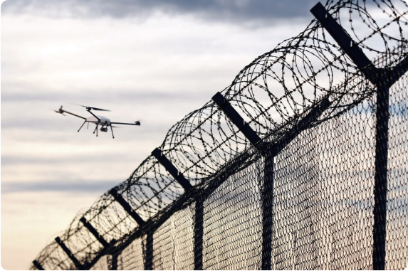
DEPARTMENT OF COMPUTER SCIENCE & ENGINEERING
Uttara University
01 — Introduction & Background
Critical Defense Requirement: Border surveillance is essential for national security, preventing illegal crossings, smuggling, and hostile incursions across vast, harsh terrains.
Limitations of Traditional Systems: Foot patrols and static CCTV towers are expensive, slow, geographically restricted, and highly prone to human fatigue or blind spots.
The UAV Solution: Unmanned Aerial Vehicles (UAVs) provide rapid mobility and aerial coverage, but encounter severe battery constraints and predictable flight paths.
Our Proposal: An Autonomous System combining physics-based energy optimization (OWT-A*), Game-Theoretic security (SSE), and a Smart Multi Relay System (SMRS) for continuous coverage.
https://static.tildacdn.one/tild6665-6132-4164-b839-363933336639/MA_border5_1.jpg
Source: microavia.com
01 — INTRODUCTION
Department of CSE · Uttara University
Page 03

Slide 4
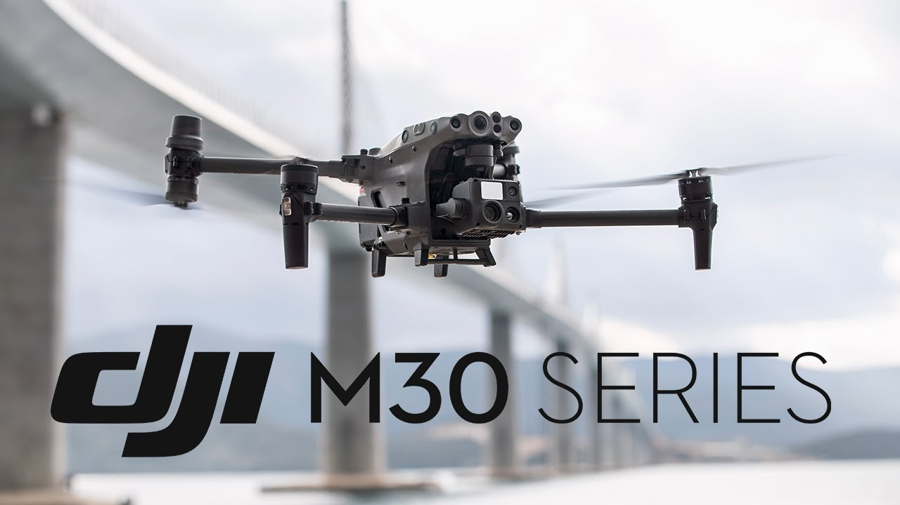






DEPARTMENT OF COMPUTER SCIENCE & ENGINEERING
Uttara University
02 — Problem Statement
Fig: DJI M30 Series
Sources: www.youtube.com/watch?v=1ucIm6g9llg
Unrealistic Battery Models
Lack of Relay & Handoff
Predictable Patrol Patterns
Existing path-planning studies rely on static, linear battery equations that fail under dynamic 3D wind drag, climb elevation, and payload avionics power loss.
Most existing systems use static, pre-computed paths. Single-drone deployments create complete surveillance blackouts when returning to base for recharging, lacking dynamic multi-UAV relay handoffs.
Drone fly fixed schedule. Fixed or cyclic patrolling schedules allow hostile intruders to observe patterns, predict surveillance gaps, and bypass border security effortlessly.
02 — PROBLEM STATEMENT
Department of CSE · Uttara University
Page 04

Slide 5




DEPARTMENT OF COMPUTER SCIENCE & ENGINEERING
Uttara University
03 — Research Objectives
01
02
Continuous Surveillance System
Realistic Physics & Two hop system
Use used a automatic handoff system.An automatic handoff system is a technology-driven process that transfers an ongoing active session, call, task, or data connection from one network cell, device, or system to another without requiring manual user intervention or causing a service disruption. create no downtime surveillance system
Formulate a comprehensive 3D energy consumption model (OWT-A*) accounting for aerodynamic wind drag (wind}), vertical elevation climb (climb), and avionics power draw.
03
04
Game-Theoretic Patrol Security
Adaptive Threat Learning & Override
Deploy Strong Stackelberg Equilibrium (SSE) combined with SUQR human adversary models to generate randomized, highly unpredictable patrol paths against rational intruders.
Integrate adaptive reinforcement learning to dynamically prioritize high-risk zones, alongside real-time safety override logic when active threats are detected.
03 — OBJECTIVES
Department of CSE · Uttara University
Page 05

Slide 6
DEPARTMENT OF COMPUTER SCIENCE & ENGINEERING
Uttara University
04 — Literature Review & Research Gaps
Paper & Year | Approach & Methodology | Limitation / Gap Addressed
Multi-UAV Coverage Path Planning: A Distributed Online Cooperation Method(2023) | Divided this area into n groups, Monitoring within their own groups | Uses linear battery models; create holes in dynamic environments
Energy-Efficient Internet of Drones Path-Planning Study Using Meta-Heuristic Algorithms (2024) | Avoiding obstacles and using the least amount of energy, Increases the stability and convergence speed of the drone's path | Lacks game-theoretic security against adversaries observing patrol routines. Not effective dynamic obstacles
Border Patrol Using Multiple Unmanned Aerial Vehicles Based on Stackelberg Security Game (2023) | Used Stackelberg Security Game (SSG),Target high-value zone first. Moving many possible paths | Lack of Real-time Adaptivity, Static Battery Constraint
04 — LITERATURE REVIEW
Department of CSE · Uttara University
Page 06

Slide 7








DEPARTMENT OF COMPUTER SCIENCE & ENGINEERING
Uttara University
05 — Research Methodology
1. Environment & Physics
2. SMRS Framework
3. Game Theory
4. Route Execution
Integrate 3D SRTM terrain mesh with dynamic wind vector attributes into OWT-A* physics engine.
Deploy Smart Multi Relay System to handle automated drone handoffs and battery-threshold return loops.
Apply Bayesian Stackelberg Security Games (SSE) & SUQR model to calculate optimal randomized patrol mixed strategies.
We use Markov Chain to convert the Stackelberg coverage strategy into a practical flight path that the drone can follow.
05 — METHODOLOGY
Department of CSE · Uttara University
Page 07

Slide 8
DEPARTMENT OF COMPUTER SCIENCE & ENGINEERING
Uttara University
06 — System Architecture
1. Environment & Inputs
3D SRTM Digital Elevation Data + Real-Time Wind Speed/Direction Vector Field
2. Physics & Energy Engine
OWT-A* Cost Function: Wind Drag + Climb Cost + Avionics Power
3. Game-Theoretic Intelligence
Bayesian Stackelberg Security Game (SSE) + SUQR Bounded Rationality Attacker Predictor (Utility= (P1 * V1) + (P2+V2))
4. SMRS Control & Pathing
Markov Chain Route Generator + Autonomous Multi-UAV Relay-Handoff Protocol
06 — SYSTEM DESIGN
Department of CSE · Uttara University
Page 08

Slide 9

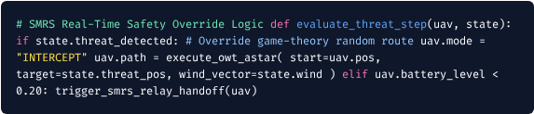
DEPARTMENT OF COMPUTER SCIENCE & ENGINEERING
Uttara University
07 — Implementation & Physics Energy Model
Energy Physics Formulations (OWT-A*)
Tools & Execution Logic
1. Wind Drag Power Cost:
2. Elevation Climb Energy:
3. Total Mechanical Work:
Environment Grid: 30×30 SRTM Elevation Grid.
Stack: Python 3.11, NumPy, Pygame GUI.
07 — IMPLEMENTATION
Department of CSE · Uttara University
Page 09

Slide 10
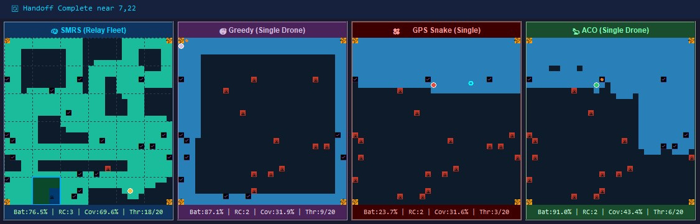
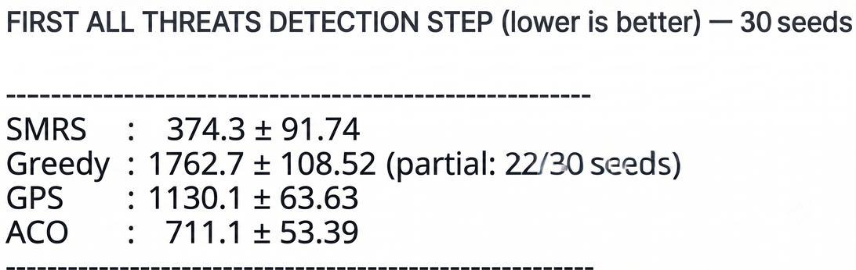
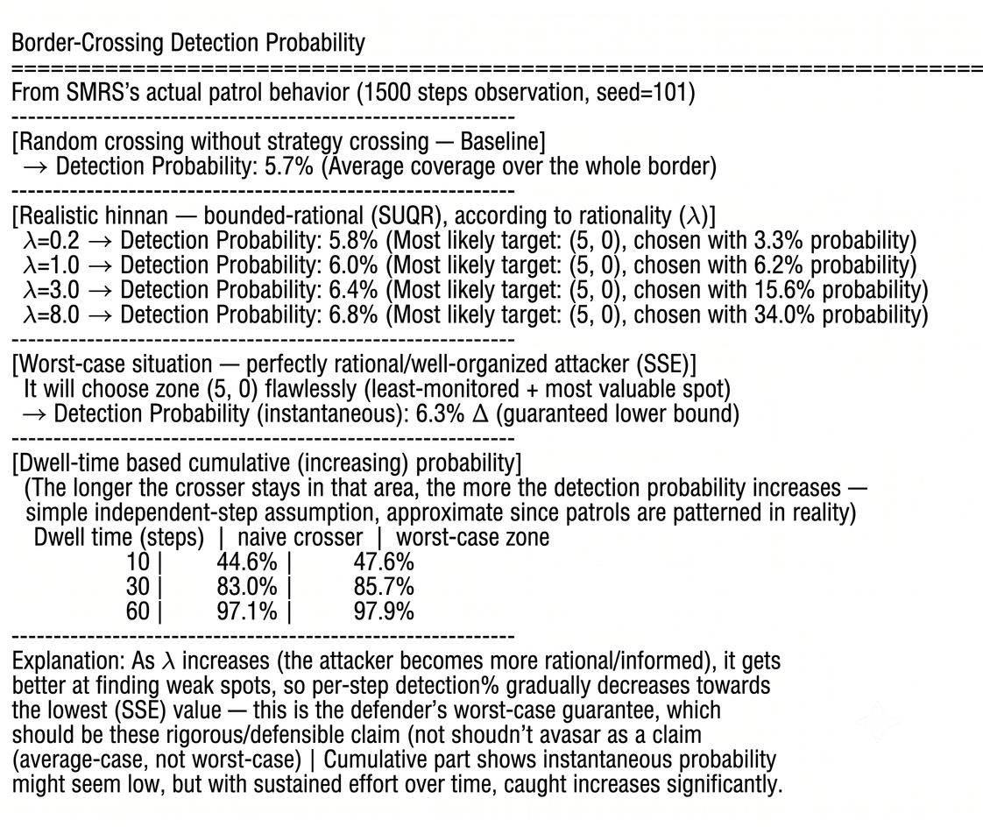
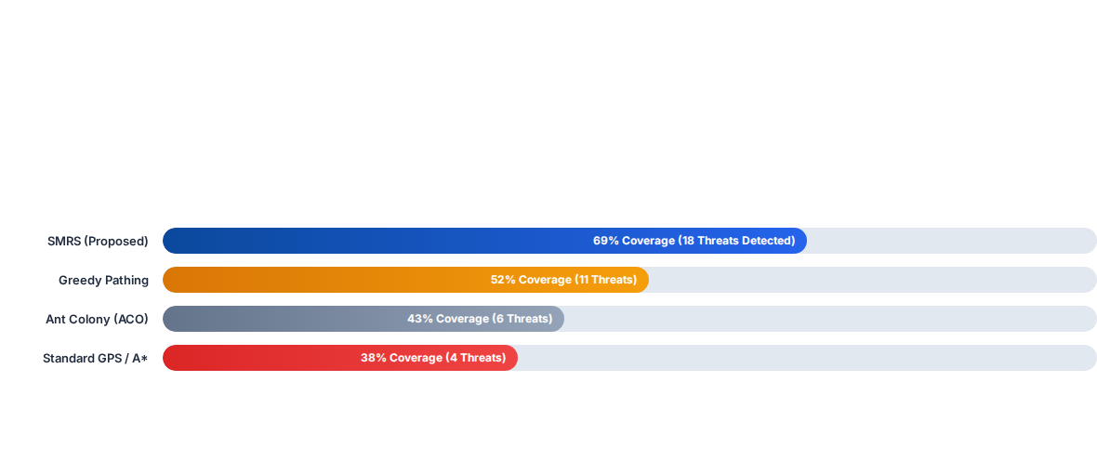



DEPARTMENT OF COMPUTER SCIENCE & ENGINEERING
Uttara University
08 — Results & Performance Analysis
Fig-2: Average all threat detect steps
Fig-1: Comparison simulation (SMRS vs Greedy vs GPS vs ACO)
Fig-3: Detection % using Game Theory
69%
18
+3.62%
Area Coverage (283 Steps)
Threats Intercepted (SMRS)
Detection Rate Gain via Adaptive Game Theory
08 — RESULTS
Department of CSE · Uttara University
Page 10

Slide 11
DEPARTMENT OF COMPUTER SCIENCE & ENGINEERING
Uttara University
09 — Comparison & Discussion
Feature / Dimension | Greedy Search | Standard A* / GPS | ACO Benchmark | Proposed SMRS (OWT-A*)
3D Wind Physics | Ignored | Ignored | Basic Drag | Full OWT-A* Engine
Route Predictability | High (Fixed) | Very High | Moderate | Zero (Game Theory SSE)
Relay Handoff | None | None | None | Autonomous SMRS
Safety Override | No | No | No | Real-Time Threat Logic
09 — COMPARISON
Department of CSE · Uttara University
Page 11

Slide 12




DEPARTMENT OF COMPUTER SCIENCE & ENGINEERING
Uttara University
10 — Conclusion & Future Work
Research Conclusion
Future Scope & Enhancements
Successfully engineered an Autonomous UAV Border Surveillance framework uniting OWT-A* energy physics with Bayesian Stackelberg Security Games (SSE).
Dynamic Micro-Weather: Upgrading static wind vectors to live dynamic micro-weather & turbulence models on VIsualization.
SMRS relay-handoff eliminated coverage blackouts during UAV battery depletion.
Improve Adaptive Learning: Enable the UAV to adapt its game-theoretic strategy based on changing threats and environmental conditions.
Achieved 69% area coverage and 18 threat interceptions, outperforming standard ACO and Greedy models.
Swarm Deployment: Expanding SMRS to multi-UAV live swarm field deployment and hardware testing.
10 — CONCLUSION
Department of CSE · Uttara University
Page 12

Slide 13
DEPARTMENT OF COMPUTER SCIENCE & ENGINEERING
Uttara University
11 — Key References
[1] Di Franco, C., & Buttazzo, G. (2015). Energy-aware coverage path planning of UAVs. IEEE International Conference on Robotics and Automation (ICRA), 7157-7162.
[2] Aggarwal, S., & Kumar, N. (2020). Path planning techniques for unmanned aerial vehicles: A review, solutions, and challenges. Computer Communications, 149, 270-299.
[3] Farr, T. G., et al. (2007). The shuttle radar topography mission (SRTM). Reviews of Geophysics, 45(2), RG2004.(SRTM)
[4] Lian, F., et al. (2024). WA-LPA*: An Energy-Aware Path-Planning Algorithm for UAVs in Dynamic Wind Environments. Drones, 9(12), 850.(OWT)
[5] Basilico, N., Gatti, N., & Amigoni, F. (2009). Leader-follower strategies for robotic patrolling in environments with arbitrary topologies. IEEE Transactions on Robotics, 25(6), 1317-1331.(SSE)
[6] Yang, R., Kiekintveld, C., Ordóñez, F., Tambe, M., & John, R. (2011). Improving resource allocation strategy against human adversaries in security games. IJCAI Proceedings, 22(1), 458-464.((SUQR)
[7] Ref: Valavanis, K. P., & Vachtsevanos, G. J. (2015). Handbook of Unmanned Aerial Vehicles (Vol. 1). Springer Publishing Company, Incorporated. (Chapter: UAV Simulation and Visualization). (GUI)
[8] Border Patrol Using Multiple Unmanned Aerial Vehicles Based on Stackelberg Security Game (2023)
[9] Energy-Efficient Internet of Drones Path-Planning Study Using Meta-Heuristic Algorithms (2024)
11 — REFERENCES
Department of CSE · Uttara University
Page 13

Slide 14


DEPARTMENT OF COMPUTER SCIENCE & ENGINEERING
Uttara University
12 — Acknowledgement
We express our deepest gratitude to our honourable supervisor Shebika Rani, Lecturer, Department of Computer Science & Engineering, Uttara University, for her invaluable guidance, constant encouragement, and constructive feedback throughout this thesis.
We also extend our sincere appreciation to the Department of CSE, Uttara University, faculty members, lab staff, and our peers and families for their unwavering support.
12 — ACKNOWLEDGEMENT
Department of CSE · Uttara University
Page 14

Slide 15

DEPARTMENT OF COMPUTER SCIENCE & ENGINEERING
Uttara University
Thank You!
Questions & Discussion
Uttara University
Continuous Autonomous Border Surveillance System

